Slide 1

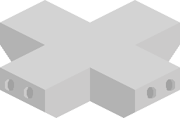

Crosley Tower
Defense
Logan Castonguay

Slide 2
Team Members
Project Advisor
Logan Castonguay
Computer Science
castonln@mail.uc.edu
Hrishikesh Vinayak Bhide
bhidehk@ucmail.uc.edu

Slide 3
Purpose and Goals
Purpose - To create a tower defense-style game based on UC.
Goals - Showcasing a functional game at the 2026 CEAS Expo, publishing a functional game with a working leaderboard, learning more about C#, Unity, and game development.

Slide 4
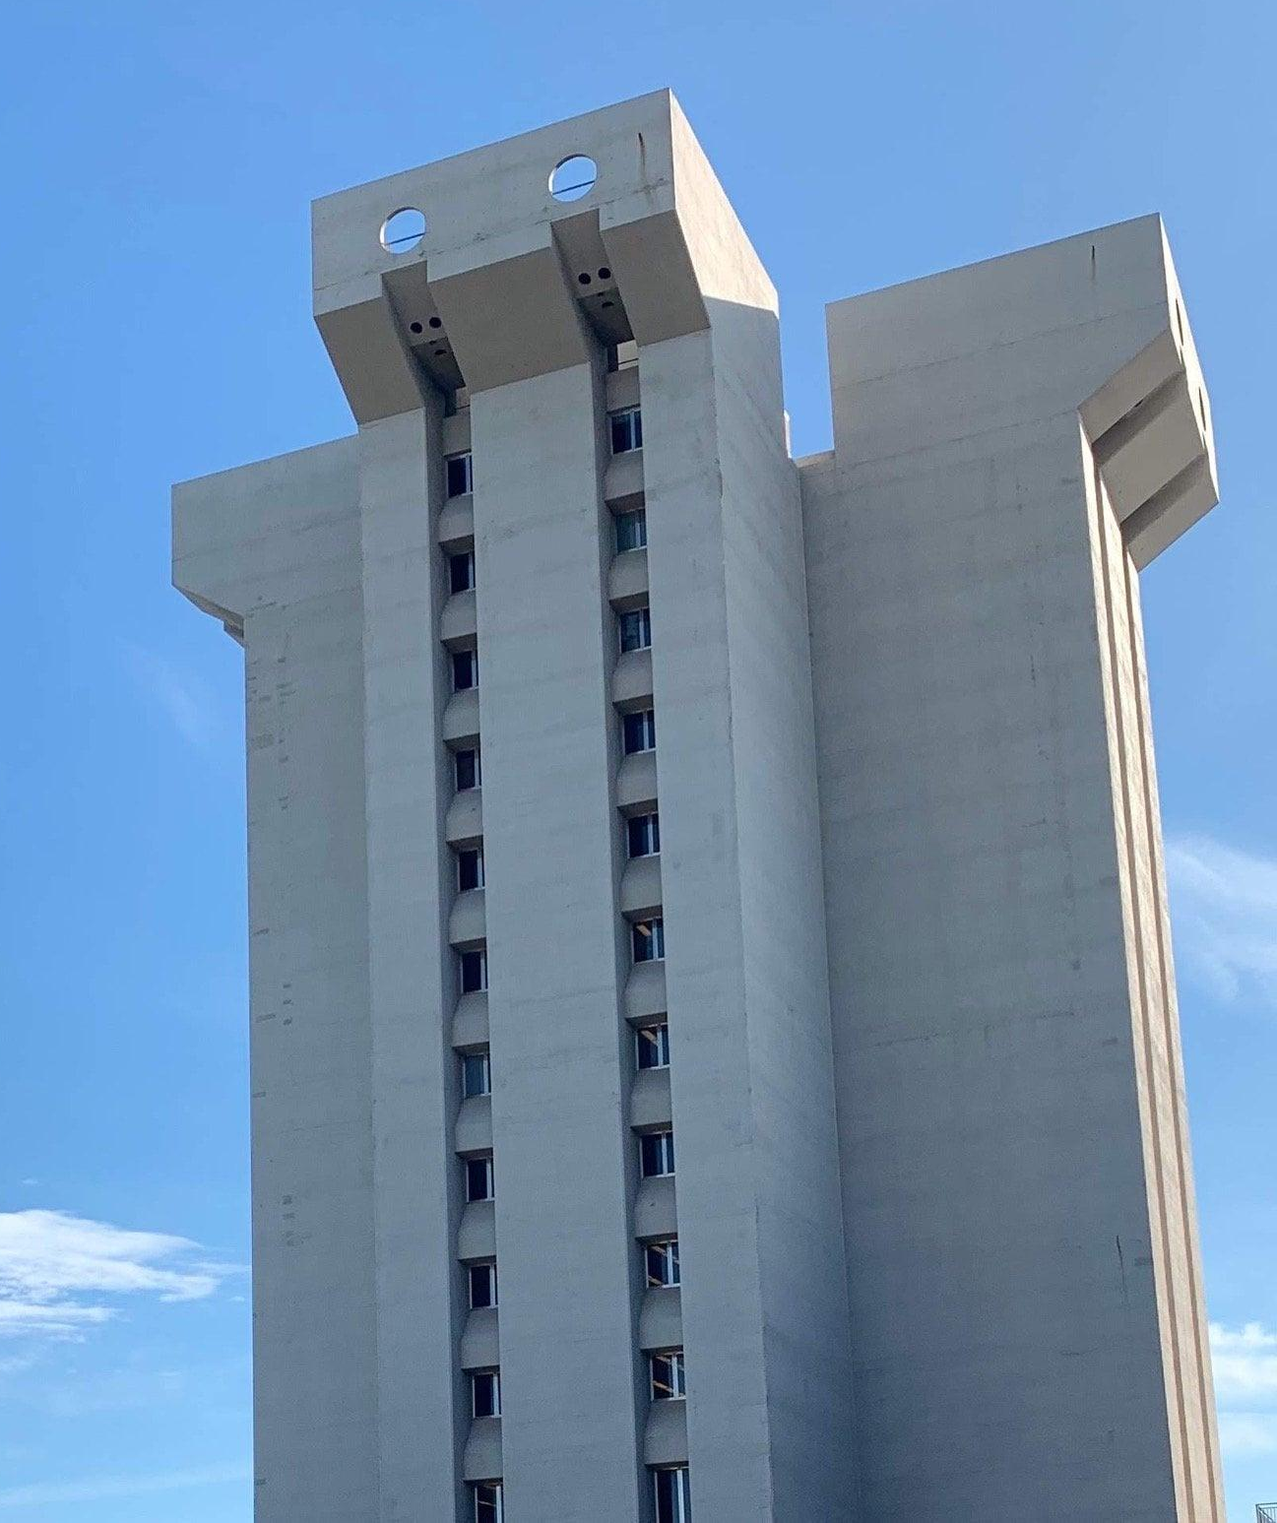
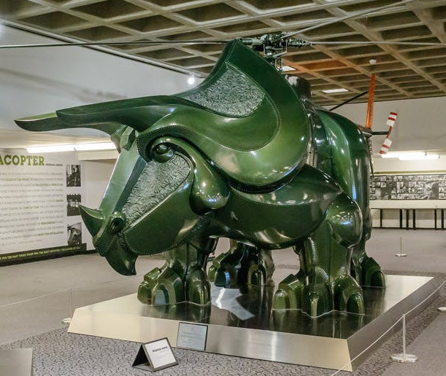
Abstract
Crosley Tower Defense is a tower defense game set on UC's campus. The goal is to defend the now ill-fated Crosley Tower from demolition. Players will be able to strategically place students to protect the tower from waves of Triceracopters (as found in Langsam Library) who remove the tower floor by floor. Each student will be representative of one of around 5 majors offered at UC, and have abilities depending on their field of study. The goal is to create a game that is a topical and fun way to bolster school spirit among students, especially incoming 2026 freshmen.

Slide 5
Intellectual Merits
Game creation from the ground up
A tower defense game from an isometric perspective
A game specifically about UC for UC students to enjoy

Slide 6
Broader Impacts
The main intention of the project is to help foster a sense of community among UC students and create a game that is fun, challenging, and shareable.
Sharing high scores on the game’s leaderboard is a great icebreaker or talking point. And the game’s subject is a unique experience that can only be fully appreciated by UC students.

Slide 7
Design Specifications

Slide 8
User Stories
As a University of Cincinnati student, I want a public leaderboard and easy sharing functionality so that I may share the game with my friends.
As an experienced gamer, I want to experience an unlimited number of waves and solve said waves with a variety of solutions so that the game I'm playing has a satisfying gameplay loop.
As an inexperienced gamer, I want the game's controls to be intuitive and access to playing it to be easy so that I can play without too much prior knowledge.

Slide 9
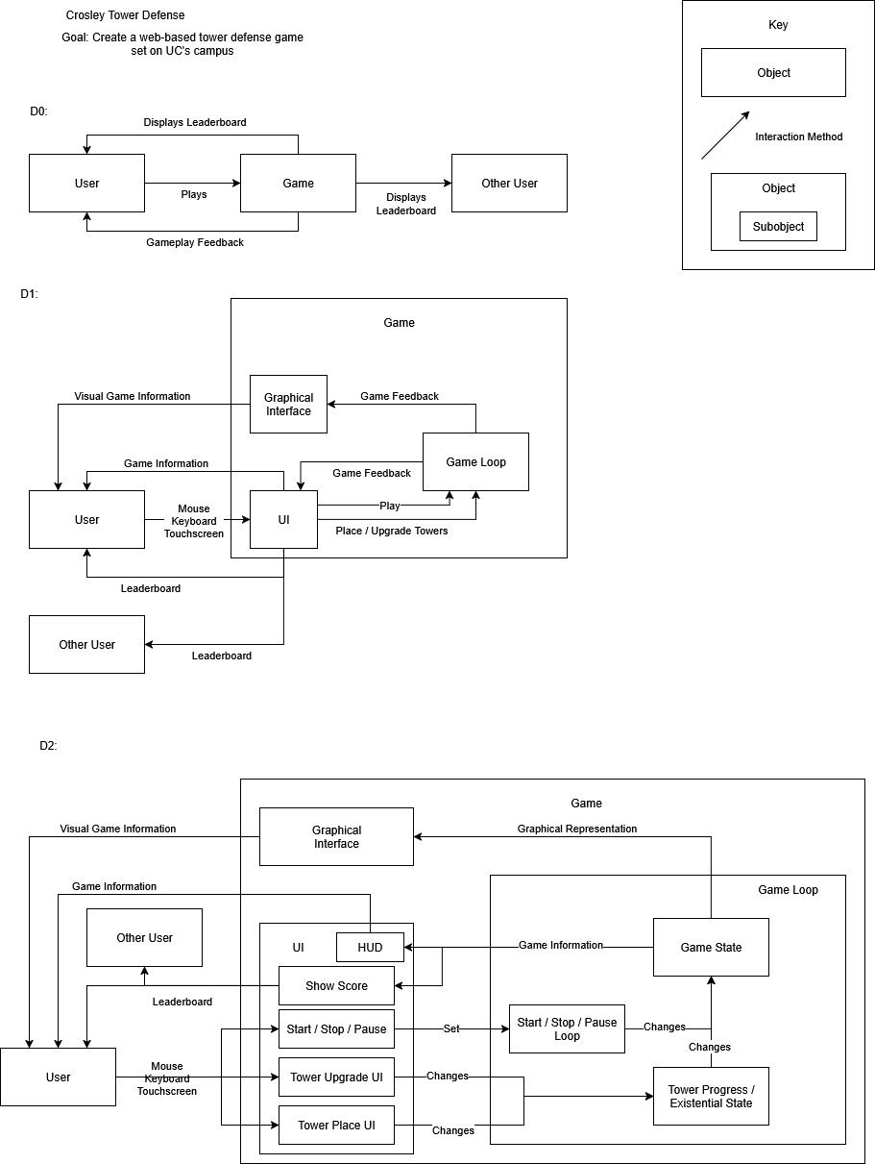

Slide 11


Technologies Used
Unity game engine
The basic backbone of the game
C#
The language which Unity uses. Unity has specialized libraries that are used in C# to expedite the game dev process
Adobe Photoshop
Used to make the very basic sprites used in game

Slide 12
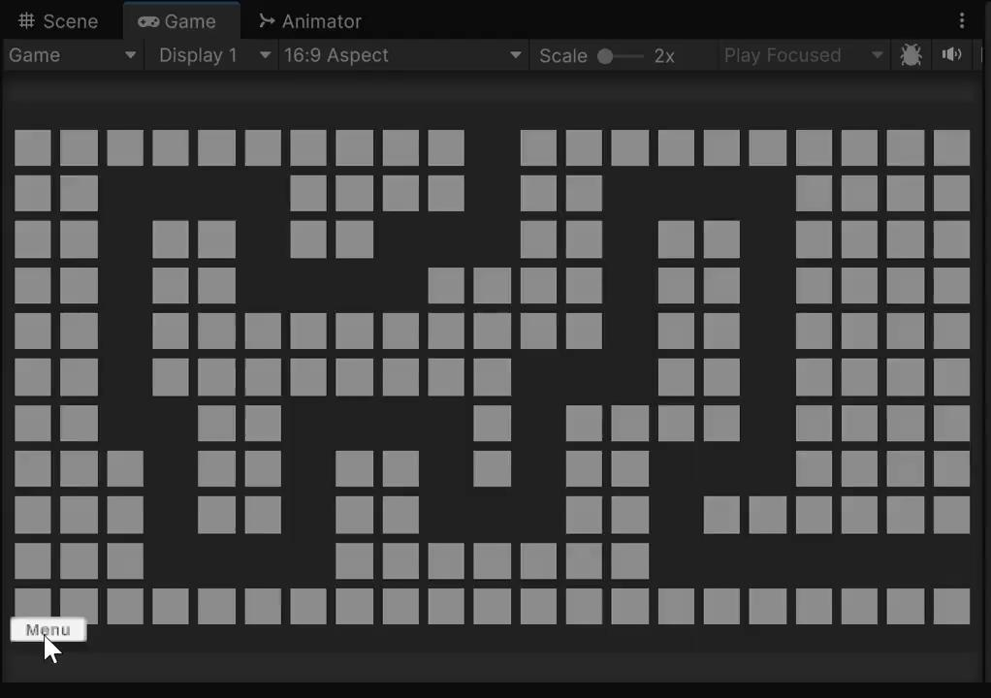
Demo
This is the initial prototype from a simple, top-down perspective. The logic for these components is very reusable, but must be adapted to the new perspective and art of the final product.

Slide 13
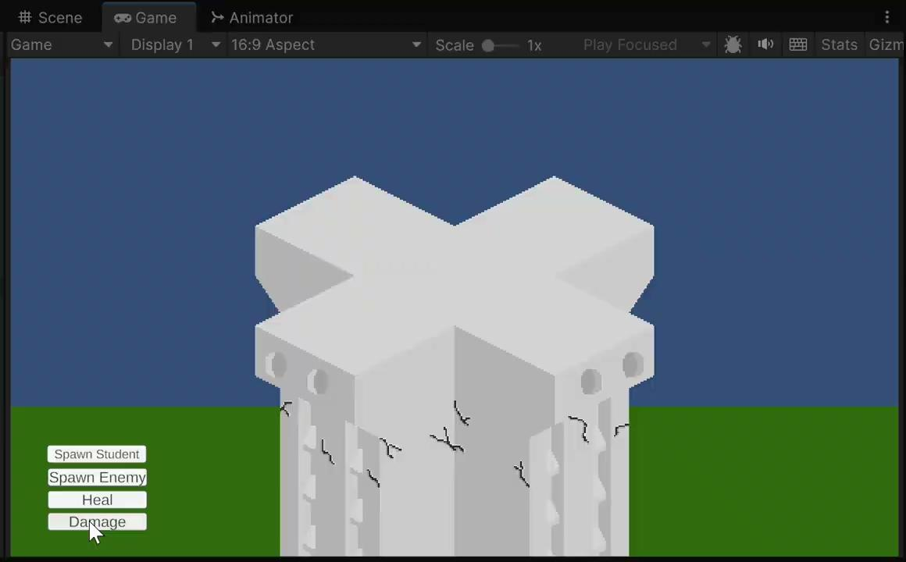
Demo
Logic for tower damage, healing, enemies, etc. is implemented. Developer tools are used now to show this. Later, enemies will spawn in waves, and users will be able to place towers in customized ways. The art is temporary and (hopefully) not final.

Slide 14
Project Constraints
Financial - Small budget -> Using Unity with free license
Legal - Project uses UC imagery -> No profiting off the work, and respectful as possible
Cultural - Featuring student characters from UC -> Making sure they represent an accurate slice of the student body

Slide 15
Challenges
Learning Unity game engine and Unity-specific C# libraries
Aided through the completion of the Unity pathways tutorial
Understanding the basic programming requirements for a tower defense game
Solved via the completion of a more basic prototype game with final functionality

Slide 16
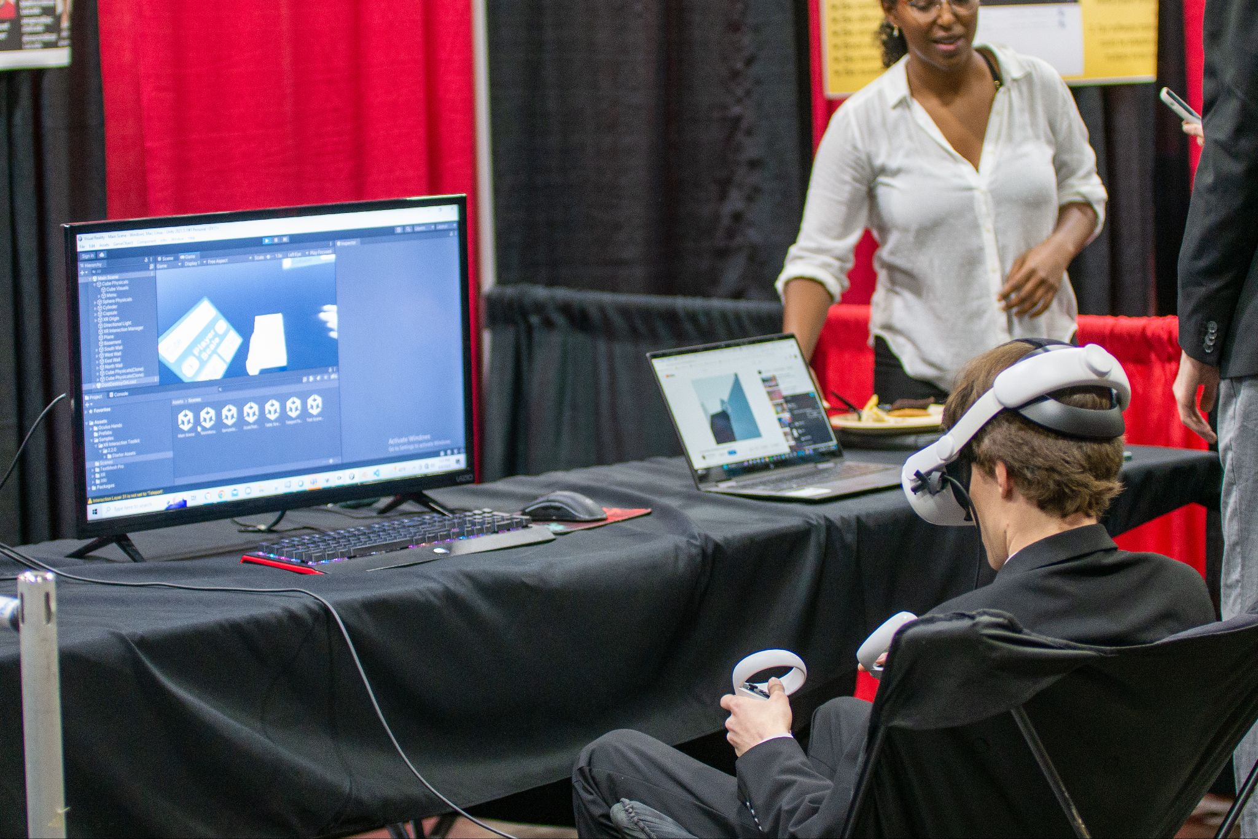
Expected Demo
Fully playable game with some waves designed
Functional live demo of the game on a PC that people can play

